Slide 1
EIE 411 Computer Organization and Architecture
MODULE 3 (Part A): ALU ; Introduction to RISC and CISC

Slide 2
PREAMBLE
What is a Computer System?
A computer system consists of two major elements: hardware and software. Computer hardware is the collection of all the parts you can physically touch. Computer software, on the other hand, is not something you can touch. Software is a set of instructions for a computer to perform specific operations. You need both hardware and software for a computer system to work.

Slide 3
PREAMBLE
The most critical component of the computer hardware is the motherboard, a plastic board on which several essential components are mounted. This includes the central processing unit (CPU), the main memory, the expansions slots for additional peripherals, the internal hard disk drive (which serves as the mass storage device for data files and software applications), and an optical disk drive (which makes it possible to read from and write to CDs and DVDs).

Slide 4
Assignment submission date Monday 12/9/16, latest 3.00pm in my officer.
Explain in details (least five points) the basic tasks that must be performed by a Central Processing Unit (CPU)?
Give an example to distinguish computer architecture and computer organization?
(3) Use binary number to solve the following in a 8 bit binary (i) -27 (ii) 18-27

Slide 5
Assignment submission date Monday 12/9/16, latest 3.00pm in my officer.
What are the basic Computer Model and different units of Computer and their functions?

Slide 6
(Assignment no. 4 Hints) Basic Computer Model and different units of Computer
The model of a computer can be described by four basic units in high level abstraction which is shown in figure below. These basic units are:
Central Processor Unit
Input Unit
Output Unit
Memory Unit

Slide 7
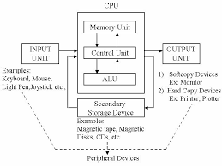
Basic Unit of a Computer

Slide 8
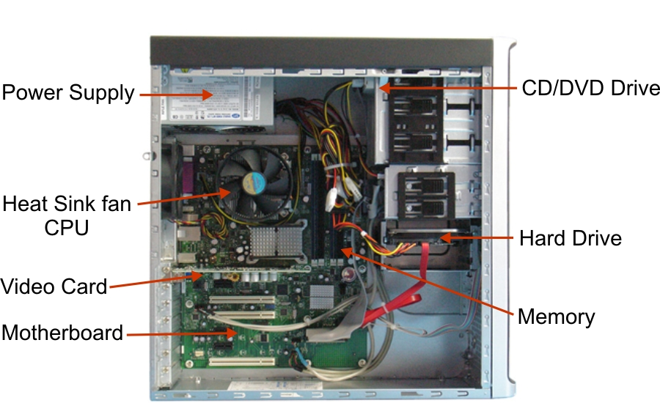
PREAMBLE

Slide 9
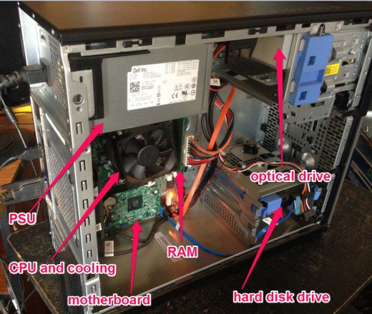
PREAMBLE

Slide 10
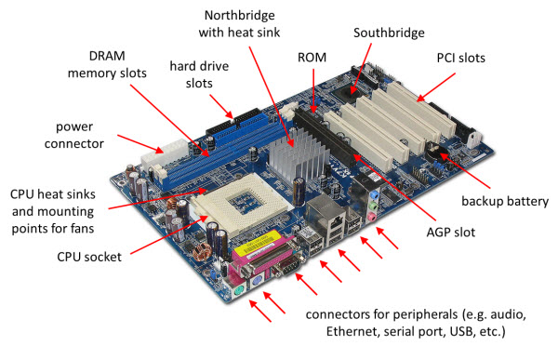
PREAMBLE

Slide 11
PREAMBLE
What is an electronic circuit?
An electronic circuit is composed of individual electronic components such as resistors, transistors, capacitors, inductors and diodes, connected by conductive wires or traces through which electric current can flow. The combination of components and wires allows various simple and complex operations to be performed: signals can be amplified, computations can be performed, and data can be moved from one place to another.

Slide 12
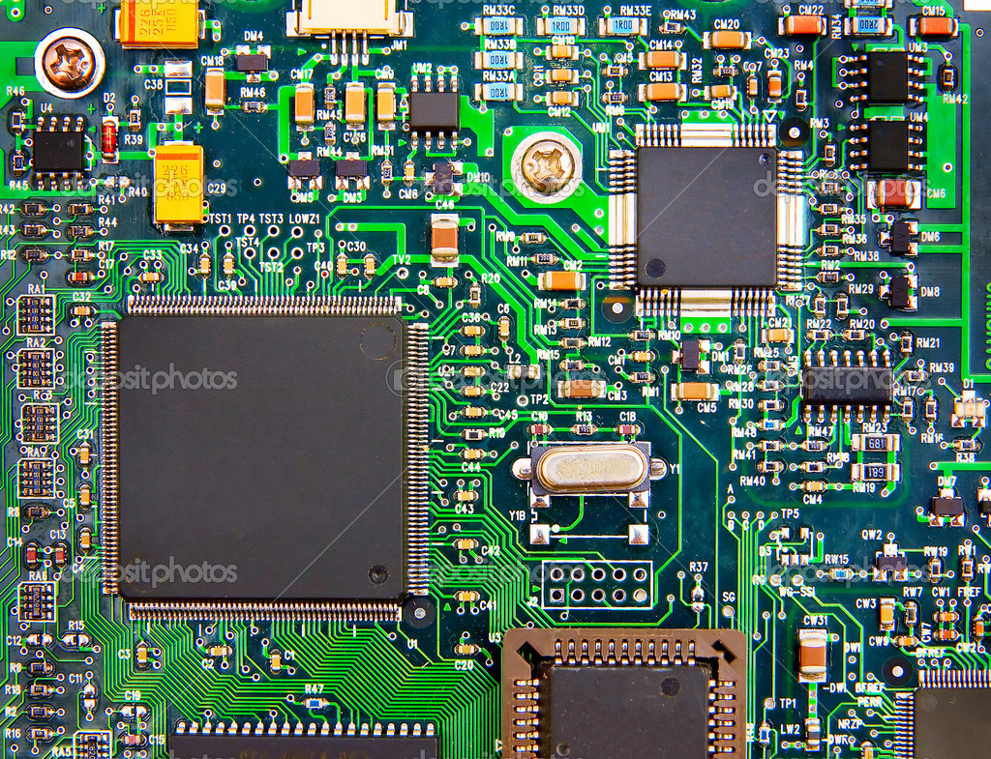
PREAMBLE

Slide 13
ALU (Arithmetic Logic Unit)
What is an ALU?
An arithmetic logic unit (ALU) is a digital electronic circuit used to perform arithmetic and logic operations. It represents the fundamental building block of the central processing unit (CPU) of a computer.

Slide 14
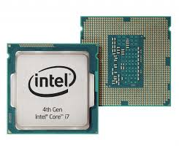
ALU (Arithmetic Logic Unit) cont.
In addition to ALUs, modern CPUs contain a Control Unit (CU) and Registers.

Slide 15
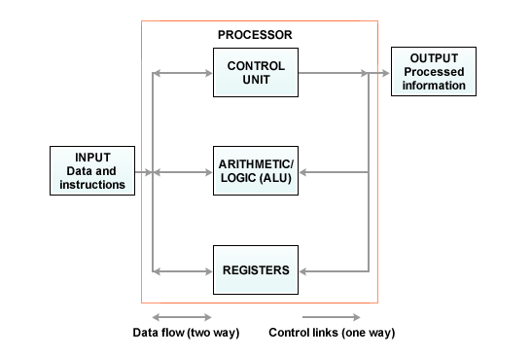
ALU (Arithmetic Logic Unit) cont.

Slide 16
ALU (Arithmetic Logic Unit) cont.
Most of the operations of a CPU are performed by one or more ALUs, which load data from input registers. A register is a small amount of storage available as part of a CPU. It supplies operands to the ALU and store the results of ALU operations.
The control unit tells the ALU what operation to perform on that data and the ALU stores the result in an output register. The control unit moves the data between these registers, the ALU, and memory.

Slide 17
ALU (Arithmetic Logic Unit) cont.
Note:
An operand is part of a computer instruction that specifies the data to be operated on or manipulated. Basically, a computer instruction describes an operation (add, subtract, and so forth)and the operand or operands on which the operation is to be performed.

Slide 18
ALU (Arithmetic Logic Unit) cont.
Modern CPUs contain very powerful and complex ALUs. Most modern CPUs are microprocessors, meaning they are contained on a single IC chip.
An IC that contains a CPU may also contain memory, peripheral interfaces, and other components of a computer; such integrated devices are called microcontrollers.

Slide 19
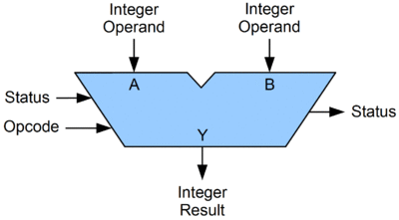
ALU (Arithmetic Logic Unit) cont.
A Symbolic representation of an ALU and its input and output signals:

Slide 20
ALU (Arithmetic Logic Unit) cont.
An ALU has a variety of input and output signals, which are the shared electrical connections used to convey digital signals between the ALU and external circuitry.
A basic ALU has three parallel data buses consisting of 2 input operands (A and B) and a result output (Y).

Slide 21
ALU (Arithmetic Logic Unit) cont.
Opcode: The opcode input is a parallel bus that conveys to the ALU an operation selection code, which is an enumerated value that specifies the desired arithmetic or logic operation to be performed by the ALU.
Status: The status outputs are various individual signals that convey supplemental information about the result of an ALU operation.

Slide 22
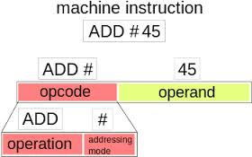
ALU (Arithmetic Logic Unit) cont.

Slide 23
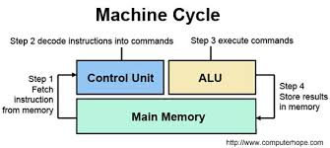
ALU (Arithmetic Logic Unit) cont.

Slide 24
ALU (Arithmetic Logic Unit) cont.
How an ALU Works
An ALU performs basic arithmetic and logic operations. Examples of arithmetic operations are addition, subtraction, multiplication, and division. Examples of logic operations are comparisons of values such as NOT, AND, OR and EX-OR.

Slide 25

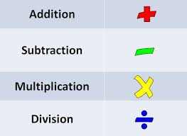
ALU (Arithmetic Logic Unit) cont.

Slide 26
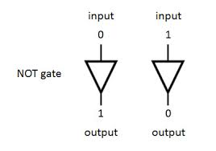
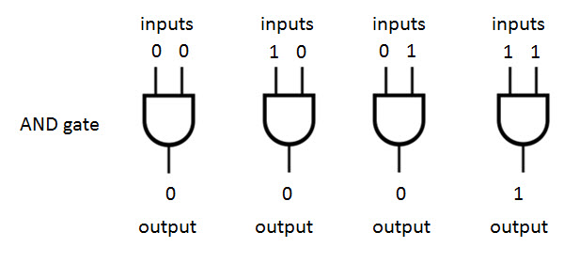
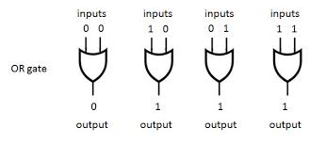
ALU (Arithmetic Logic Unit) cont.

Slide 27

ALU (Arithmetic Logic Unit) cont.
All information in a computer is stored and manipulated in the form of binary numbers, i.e. 0 and 1.

Slide 28
ALU (Arithmetic Logic Unit) cont.
Transistor switches are used to manipulate binary numbers since there are only two possible states of a switch: open or closed. An open transistor, through which there is no current, represents a 0. A closed transistor, through which there is a current, represents a 1.

Slide 29
ALU (Arithmetic Logic Unit) cont.
Operations can be accomplished by connecting multiple transistors. One transistor can be used to control a second one in effect, turning the transistor switch on or off depending on the state of the second transistor. This is referred to as a gate because the arrangement can be used to allow or stop a current.

Slide 30
ALU (Arithmetic Logic Unit) cont.
The simplest type of operation is a NOT gate. This uses only a single transistor.
It uses a single input and produces a single output, which is always the opposite of the input.

Slide 31
ALU (Arithmetic Logic Unit) cont.
This figure shows the logic of the NOT gate.

Slide 32
ALU (Arithmetic Logic Unit) cont.
Other gates consist of multiple transistors and use two inputs. The OR gate results in a 1 if either the first or the second input is a 1. The OR gate only results in a 0 if both inputs are 0.

Slide 33
ALU (Arithmetic Logic Unit) cont.
This figure shows the logic of the OR gate.

Slide 34
ALU (Arithmetic Logic Unit) cont.
The AND gate results in a 1 only if both the first and second input are 1s. This figure shows the logic of the AND gate.

Slide 35
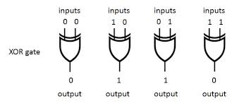
ALU (Arithmetic Logic Unit) cont.
The XOR gate, also pronounced X-OR gate, results in a 0 if both the inputs are 0 or if both are 1. Otherwise, the result is a 1. This figure shows the logic of the XOR gate.

Slide 36
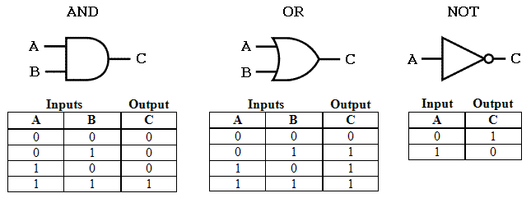
ALU (Arithmetic Logic Unit) cont.

Slide 37
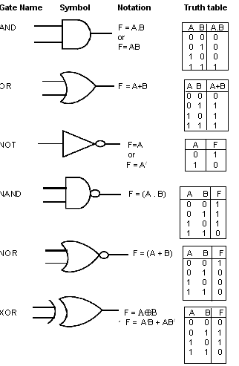
ALU (Arithmetic Logic Unit) cont.

Slide 38
ALU (Arithmetic Logic Unit) cont.
Note that different combinations of the logic gates make it possible for the computer to perform arithmetic operations.
For example, in binary code, the number 2 is represented as one-zero and the number 3 is represented as one-one. So how does a computer add 2 and 3? The calculation is implemented using a series of OR, AND, and XOR gates. The result of the logical processing steps is one-zero-one, which is binary code for 5.

Slide 39
ALU (Arithmetic Logic Unit) cont.
The gates make it possible for a computer to break down any complex operation into a very large number of binary steps. At first, this may seem like a rather cumbersome system to perform a simple addition; however, a computer can perform these operations at the speed of its CPU, which is measured in gigahertz, or trillions of calculations per second.

Slide 40
ALU (Arithmetic Logic Unit) cont.
In addition, a typical CPU contains hundreds of millions of transistors, which make it possible to create very sophisticated ALUs. A computer also processes much larger binary sequences at a time. As a result, complex operations can be performed in fractions of a second.

Slide 41
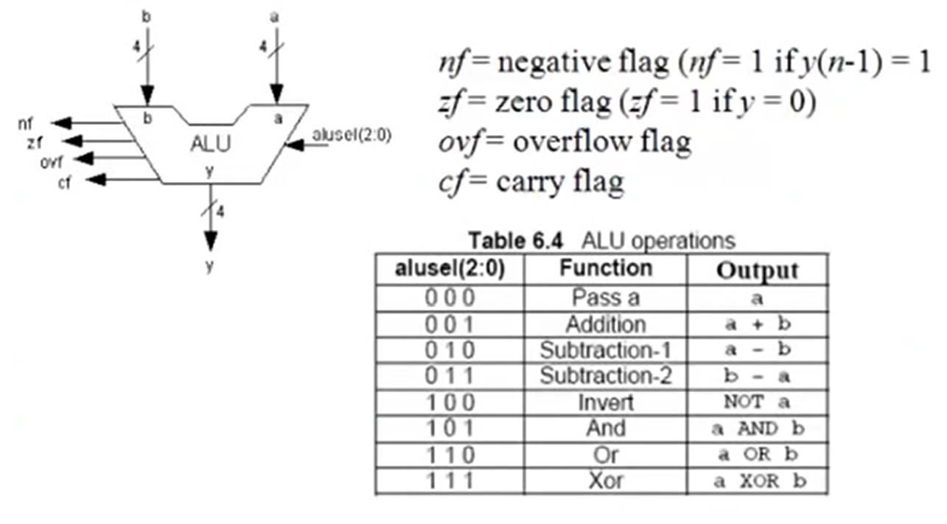
ALU (Arithmetic Logic Unit) operations

Slide 42
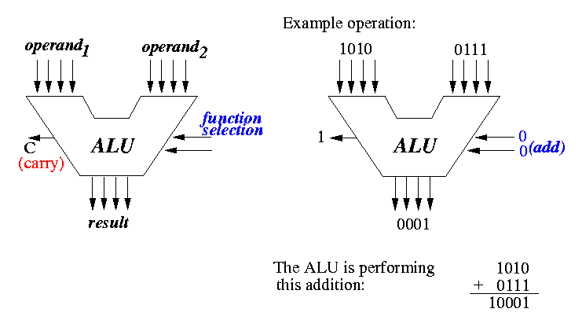
ALU (Arithmetic Logic Unit) opera

Slide 43
What is the basic Working Principle of a Computer?
Before going into the details of working principle of a computer, we will analyze how computers work with the help of a small hypothetical computer.
In this small computer, we do not consider about Input and Output unit. We will consider only CPU and memory module. Assume that somehow we have stored the program and data into main memory. We will see how CPU can perform the job depending on the program stored in main memory.

Slide 44
Assignment submission date Monday 12/9/16, latest 3.00pm in my officer. Cont from slide 6
5. Draw a block diagram of a simple computer machine, indicate the direction of flow and explain the function of each of the components ( Hint: consider only CPU and memory module i.e. Memory, PC, MAR,IR,MBR,ALU,ACC., Read, Write and Ready ).

Slide 45
YES? OR NO?
My assumption is that students understand common terms like program, CPU, memory etc. without knowing the exact details.

Slide 46
Consider the Arithmetic and Logic Unit (ALU) of Central Processing Unit :
Consider an ALU which can perform four arithmetic operations and four logical operations To distinguish between arithmetic and logical operation, we may use a signal line,
0 - in that signal, represents an arithmetic operation and
1 - in that signal, represents a logical operation.

Slide 47
Consider the Arithmetic and Logic Unit (ALU) of Central Processing Unit: Cont.
In the similar manner, we need another two signal lines to distinguish between four arithmetic operations.

Slide 48
The different operations and their binary code is as follows:

Slide 49
Consider the Arithmetic and Logic Unit (ALU) of Central Processing Unit: Cont.
Consider the part of control unit; its task is to generate the appropriate signal at right moment.
There is an instruction decoder in CPU which decodes this information in such a way that computer can perform the desired task
The simple model for the decoder may be considered that there is three input lines to the decoder and correspondingly it generates eight output lines. Depending on input combination only one of the output signals will be generated and it is used to indicate the corresponding operation of ALU.

Slide 50
Arithmetic and Logic Unit (ALU) cont.
In our simple model, we use three storage units in CPU, Two -- for storing the operand and one -- for storing the results. These storage units are known as register.
But in computer, we need more storage space for proper functioning of the Computer.

Slide 51
Arithmetic and Logic Unit (ALU) cont.
Operands are the objects that are manipulated and operators are the symbols that represent specific actions. For example, in the expression. 5 + x. x and 5 are operands and + is an operator. All expressions have at least one operand.

Slide 52
Arithmetic and Logic Unit (ALU) cont.
An opcode is short for 'Operation Code'.
An opcode is a single instruction that can be executed by the CPU. In machine language it is a binary or hexadecimal value such as 'B6' loaded into the instruction register.
In assembly language mnemonic form an opcode is a command such as MOV or ADD or JMP.
For example
MOV, AL, 34h
The opcode is the MOV instruction. The other parts are called the 'operands'.
Operands are manipulated by the opcode. In this example, the operands are the register named AL and the value 34 hex.

Slide 53
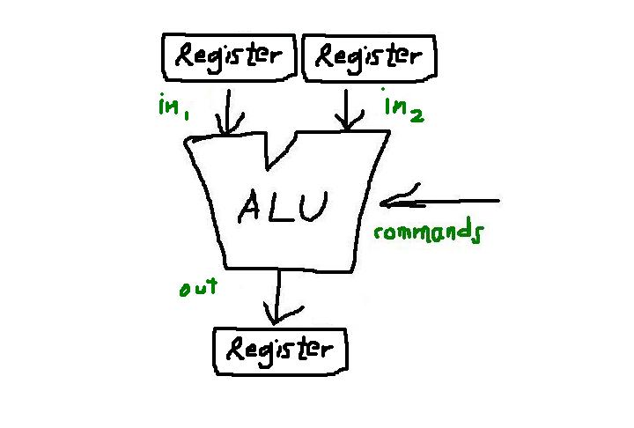
Arithmetic and Logic Unit (ALU) cont.

Slide 54
Arithmetic and Logic Unit (ALU) cont.
Some of them are inside CPU, which are known as register. Other bigger chunk of storage space is known as primary memory or main memory. The CPU can work with the information available in main memory only.
To access the data from memory, we need two special registers one is known as Memory Data Register (MDR) and the second one is Memory Address Register (MAR).

Slide 55
Arithmetic and Logic Unit (ALU) cont.
Data and program is stored in main memory. While executing a program, CPU brings instruction and data from main memory, performs the tasks as per the instruction fetch from the memory. After completion of operation, CPU stores the result back into the memory.
In next section, we discus about memory organization for our small machine.

Slide 56
Arithmetic and Logic Unit (ALU) cont.
ALU is responsible to perform the operation in the computer.
The basic operations are implemented in hardware level. ALU is having collection of two types of operations:
Arithmetic operations
Logical operations
Consider an ALU having 4 arithmetic operations and 4 logical operations.

Slide 57
Assignment submission date Monday 12/9/16, latest 3.00pm in my officer.
1.What a register in a computer system?
2. Where are they found in a computer system?
3.What are the types of registers in a computer system?
4.What are the functions of the various types of registers in a computer systems?
5.What are the main differents between computer memory and computer registers if any?

Slide 58
Arithmetic and Logic Unit (ALU) cont.
To identify any one of these four logical operations or four arithmetic operations, two control lines are needed. Also to identify any one of these two groups- arithmetic or logical, another control line is needed. So, with the help of three control lines, any one of these eight operations can be identified.

Slide 59
Arithmetic and Logic Unit (ALU) cont.
Consider an ALU is having
Four arithmetic operations: Addition, subtraction, multiplication and division. Also consider that the ALU is having
Four logical operations: OR, AND, NOT & EX-OR.
We need three control lines to identify any one of these operations. The input combination of these control lines are shown below:

Slide 60
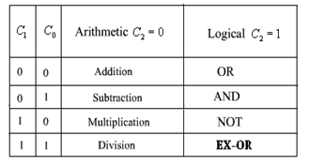
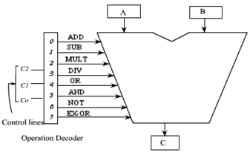
A 3 x 8 decode is used to decode the instruction and Block Diagram of the ALU

Slide 61
Arithmetic and Logic Unit (ALU) cont.
Control line C₂ is used to identify the group: logical or arithmetic, i.e. C₂=0: arithmetic operation, C₂ = 1: logical operation. Control lines C₀ and C₁ are used to identify any one of the four operations in a group. One possible combination is given here.

Slide 62
Arithmetic and Logic Unit (ALU) cont.
The ALU has got two input registers named as A and B and one output storage register, named as C. It performs the operation as:
C = A op B
The input data are stored in A and B, and according to the operation specified in the control lines, the ALU perform the operation and put the result in register C.

Slide 63
Arithmetic and Logic Unit (ALU) cont.
As for example, if the contents of controls lines are, 000, then the decoder enables the addition operation and it activates the adder circuit and the addition operation is performed on the data that are available in storage register A and B . After the completion of the operation, the result is stored in register C. We should have some hardware implementations for basic operations. These basic operations can be used to implement some complicated operations which are not feasible to implement directly in hardware.

Slide 64
Assignment submission date Monday 12/9/16, latest 3.00pm in my officer.
5. The CPU works with the information available from where in a computer systems?
6. (i)What are the two special registers needed to access the data from memory. (ii) what are their functions.
7. After completion of operation, where does CPU stores the results of its operatons?

Slide 65
Assignment submission date Monday 12/9/16, latest 3.00pm in my officer. Cont. from slide 57
8. Consider an ALU having 4 arithmetic operation and 4 logical operation. Explain how to identify any one of these four logic operations or arithmetic operations?

Slide 66


